Slide 1
CS335 Project - Communications App
By Alannah Donohoe (19486454) and
Seán Conroy (19384061)

Slide 2
Goals
Seán
Develop a “Communications” Software System by:
Creating user stories
Building a complete set of UML diagrams
Designing a mock-up of the User Interface
Outlining a set of system tests to validate the user requirements

Slide 3
User Stories
Seán
General explanation of a software feature
Written from user perspective
Used to get system requirements

Slide 4
User Story Example
Seán
James isn’t a member of any clubs or societies yet and wants a search feature within the app, so he can type in keywords about things he’s interested in and find posts from different societies and people that share the same interests as him.

Slide 5
UML Diagrams
Seán
Use Case Diagram
Sequence Diagrams
Class Diagram
Architecture Diagram

Slide 6
Use Case Diagram
Seán
Use Cases - One for each user requirement
Relationships
Include
Extend
Generalisation

Slide 7
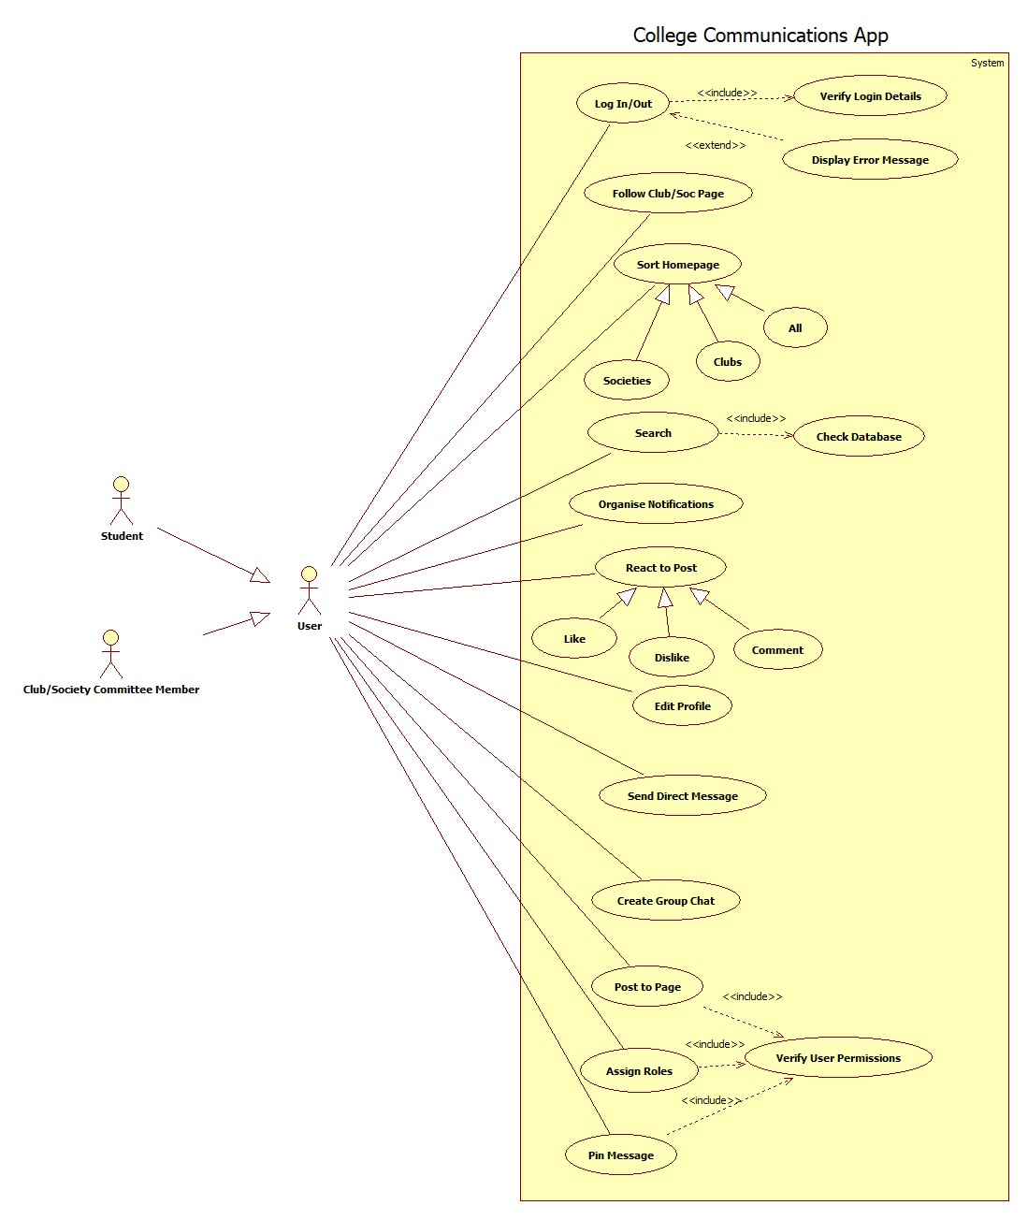
Seán

Slide 8
Sequence Diagrams
Seán
One for each use case
Chronological
Interactions between objects

Slide 9
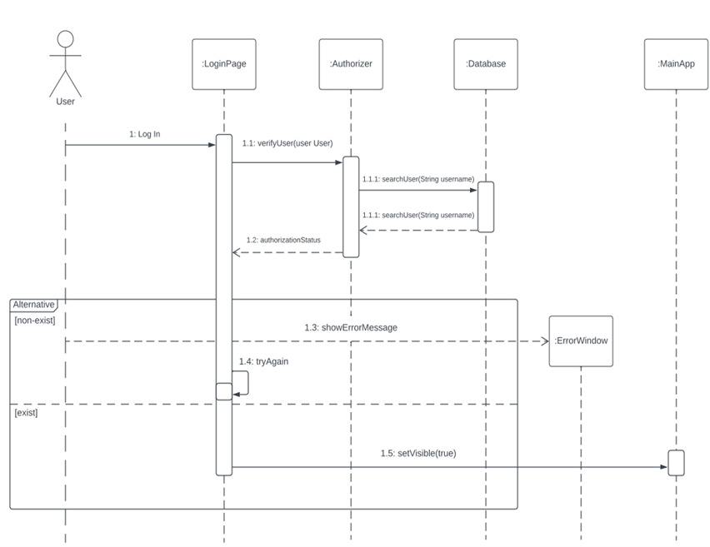
Seán

Slide 10
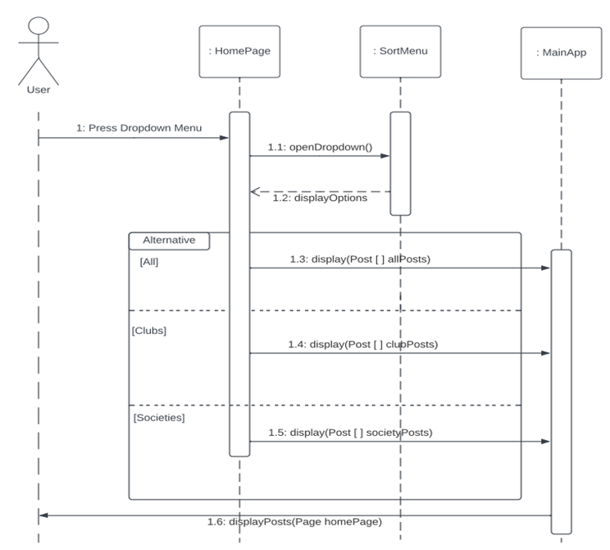
Seán

Slide 11
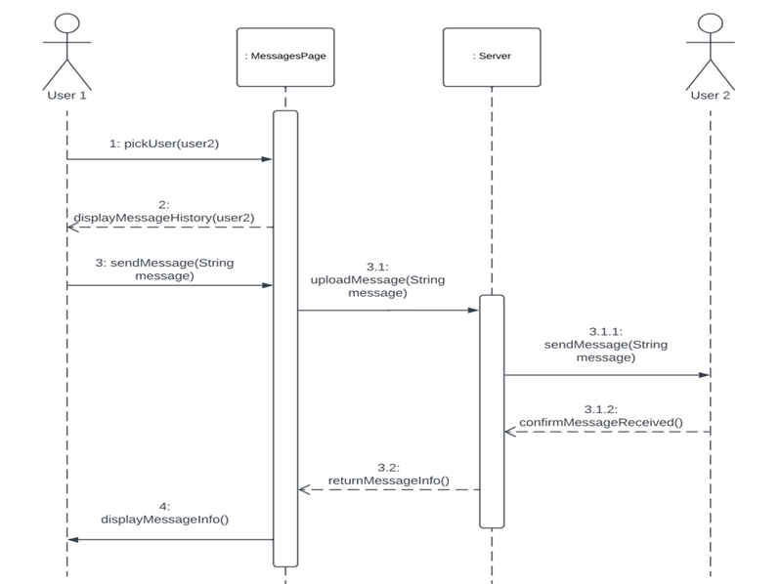
Seán

Slide 12
Class Diagram
Alannah
Portrays each class and their:
Attributes
Operations
Shows the interactions between classes

Slide 13
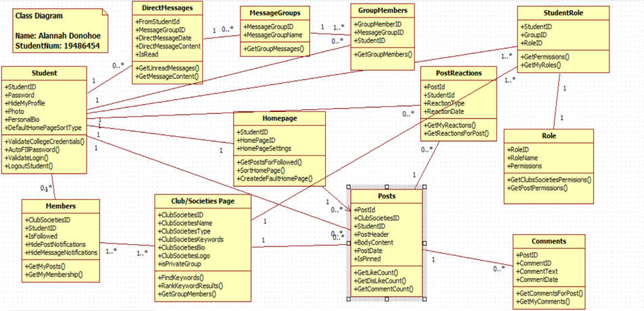
Alannah

Slide 14
Architecture Diagram
Alannah
Visual representation of the physical implementations of the components that go along with a software system.
Shows the general structure of the software system and the associations, limitations, and boundaries between each element provided.

Slide 15
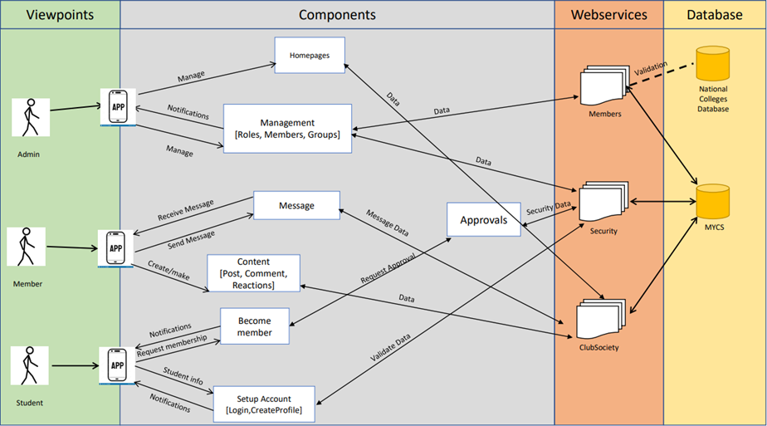
Alannah

Slide 16
User Interface (UI) Mock-Up
Seán
Shows the visual layout of how the final app will look
Designed to be as user-friendly as possible
Mirrors other communication apps

Slide 17
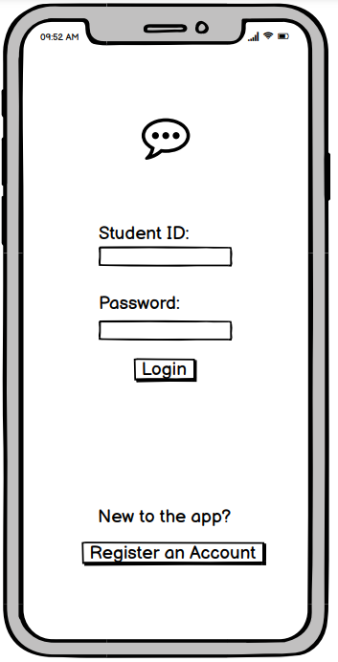
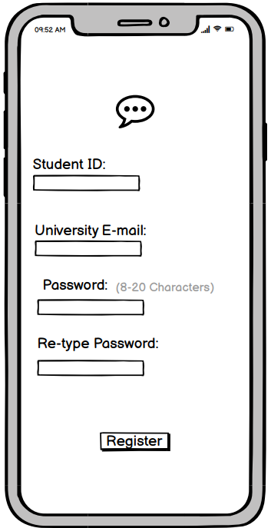
Seán

Slide 18
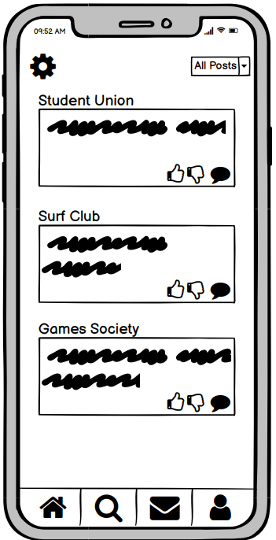
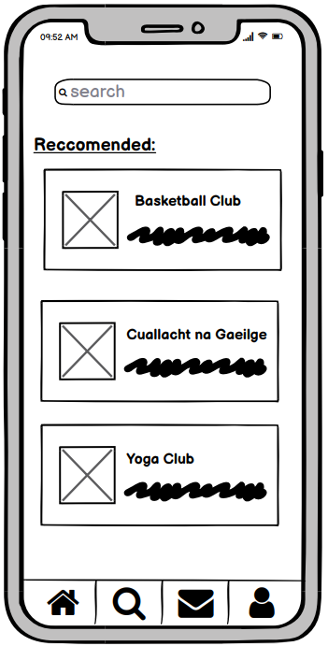
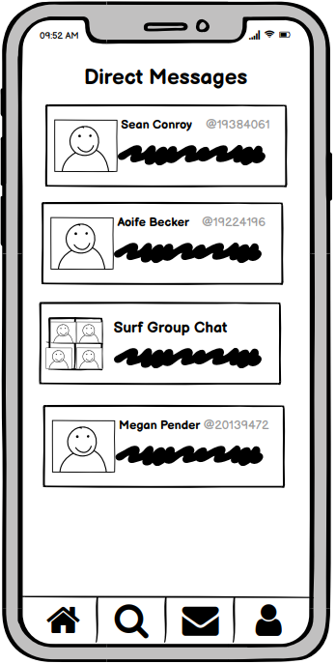
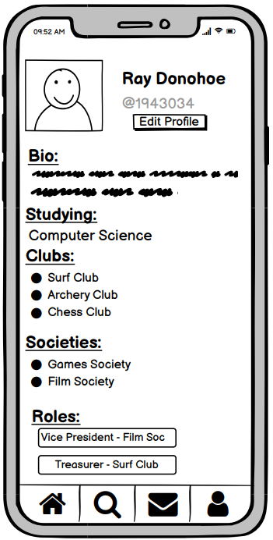
Seán

Slide 19
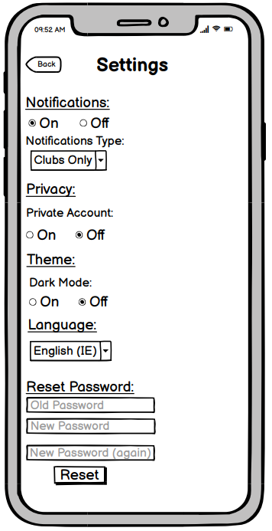
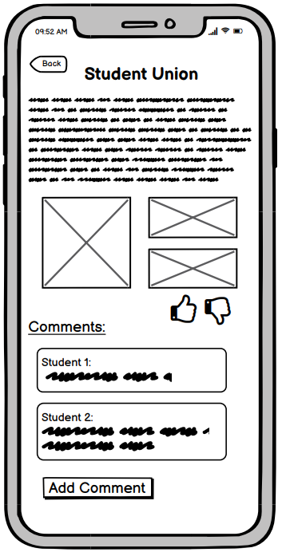
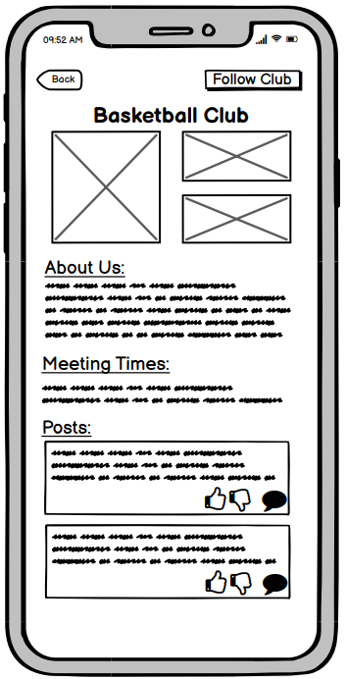
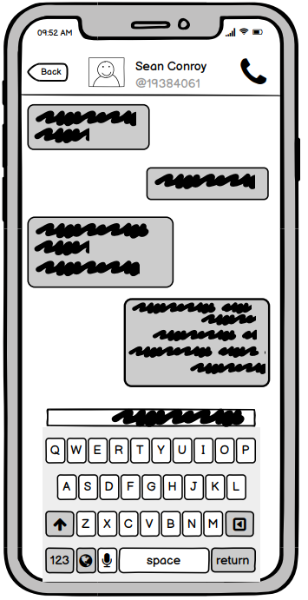
Seán

Slide 20
System Tests
Alannah
Develop a test for each requirement to be validated
Use the use cases as they are the most effective way of testing
Use appropriate test data
Expected Result
Pass/Fail

Slide 21
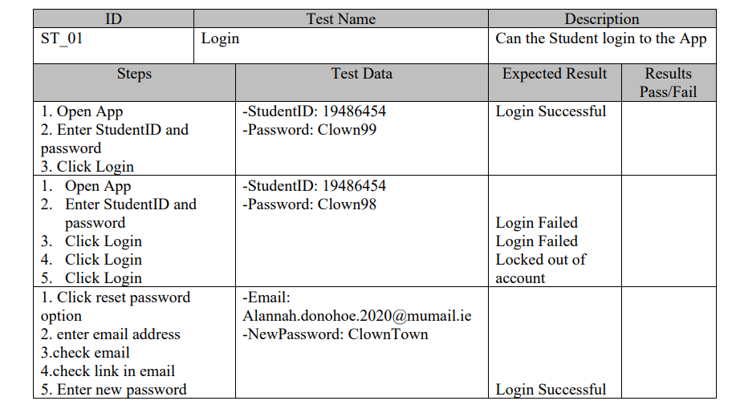
Alannah

Slide 22
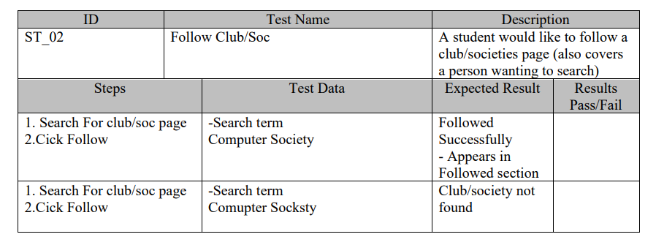
Alannah

Slide 23
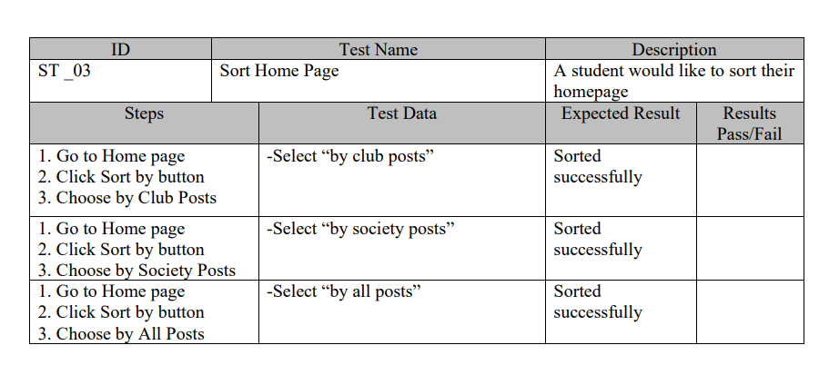
Alannah

Slide 24
Conclusion
Seán
Created user stories and extracted software requirements
Developed a full set of UML diagrams
Designed a mock-up of the User Interface
Built a set of system tests to validate the user requirements

